Slide 1

Django Interaction with DB
DB Introduction in Django

Slide 2
Information
Agenda
System
01
Create Database
Start with DB
02
Data Access
A few ways to access the data
03
Query in Database
Basic Query

Slide 3
The order of Code
The order of code | Related command / file | Contents of the code
Framework coding | Start project | The new project creation
 | settings.py | Project setting modification
 | migrate | User / group table creation
 | createsuperuser | Project admin super-user creation
 | startapp | Bookmark app production
 | settings.py | Bookmark app registration
Model coding | models.py | Model / Table definition
 | admin.py | Admin site model registration
 | makemigrations | Model modification commit
 | migrate | Any modification execution
View coding | views.py | View logic registration
URLconf coding | urls.py | URL definition
Template coding | templates directory | Web files creation
Framework Coding
This Section
Model Coding

Slide 4
Framework Coding
Starter

Slide 5
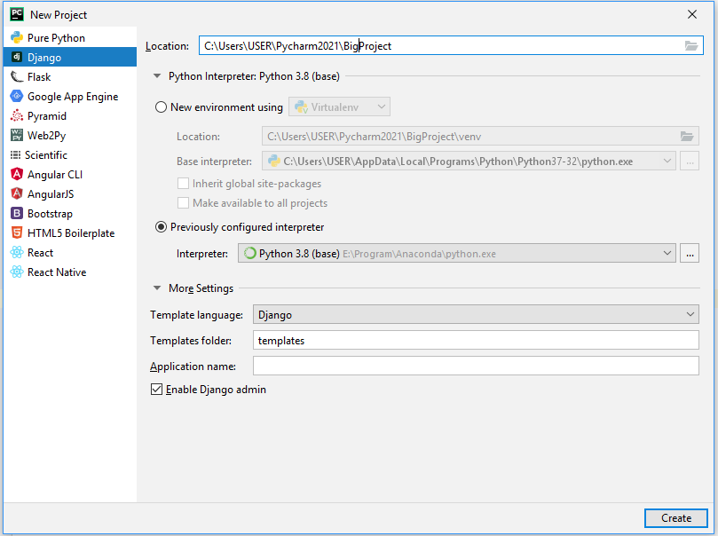
a. Start a project
1. Framework coding
Create a new project, name “BigProject”

Slide 6
b. Project Setting Modification (1)
1. Framework coding
Insert values into the ALLOWED_HOSTS
ALLOWED_HOSTS = [ ]
ALLOWED_HOSTS = ['localhost', '127.0.0.1']

Slide 7
b. Project Setting Modification (2)
1. Framework coding
NOTE!
An error in Django 3.2.5 & PyCharm Environment
In settings.py
'DIRS': [BASE_DIR / 'templates']
'DIRS': [BASE_DIR + '/templates']
It means that the folder “templates” will be the place for other relevant files (e.g., HTML, CSS, JS, images, etc.)

Slide 8

b. Project Setting Modification (3)
1. Framework coding
Selecting the databases
DATABASES = {
'default': {
'ENGINE': 'django.db.backends.sqlite3',
'NAME': os.path.join(BASE_DIR, 'db.sqlite3'),
}
}
By default, the configuration uses SQLite.
If you wish to use another database, install the appropriate database bindings and change the following keys in the DATABASES 'default' item to match your database connection settings

Slide 9
b. Project Setting Modification (4)
1. Framework coding
Language setting
LANGUAGE_CODE = 'en-us'
LANGUAGE_CODE = 'ko-kr'
'zn-ch' → simplified Chinese
'zn-tw' → traditional Chinese
By default, the configuration uses English US.
You can use Korean, if you want.
If you wish to use another language, select the proper format of the languages

Slide 10
b. Project Setting Modification (5)
1. Framework coding
Change the Time_Zone and the “Use_TZ”
TIME_ZONE = 'UTC'
TIME_ZONE = 'Asia/Seoul'
USE_TZ = True
USE_TZ = False
By default, the configuration uses UTC (Coordinated Universal Time).
You can define the Time Zone Asia/Seoul
For the “Use_TZ”, the default value is “True” to use the UTC time zone. the Database will use Asia/Seoul time zone instead of UTC when we write “False”.

Slide 11
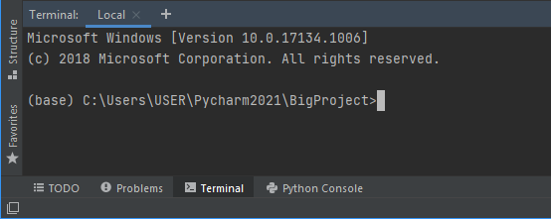
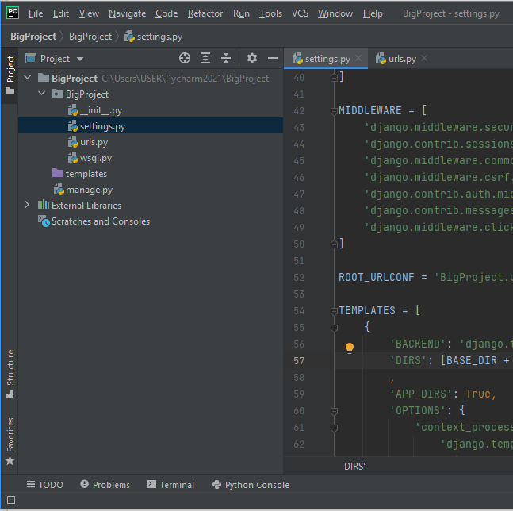
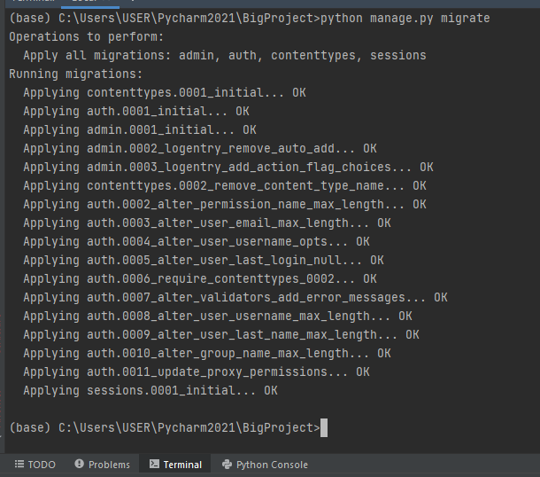
c. Migrate
1. Framework coding
1.
2.
Type: python manage.py migrate
3.
The result after the execution

Slide 12
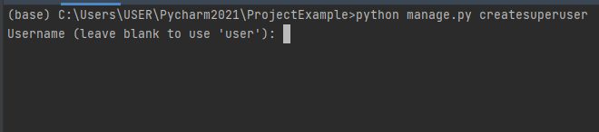
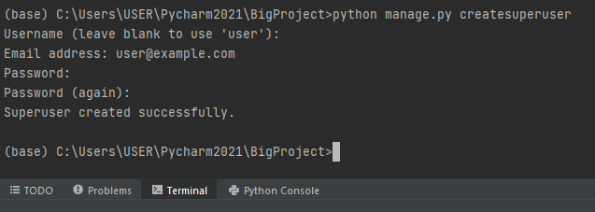
d. Create Super User
1. Framework coding
To do administration process, we need to create a user.
python manage.py createsuperuser
Leave blank to use ‘user’
Email address: put your email address to retrieve the password when you forget
Password: hufsime203
Password (again): hufsime203
Select ‘y’ if you are okay
Password can be changed. But it is for the easy reminder since there is a requirement for creating a strong password.

Slide 13
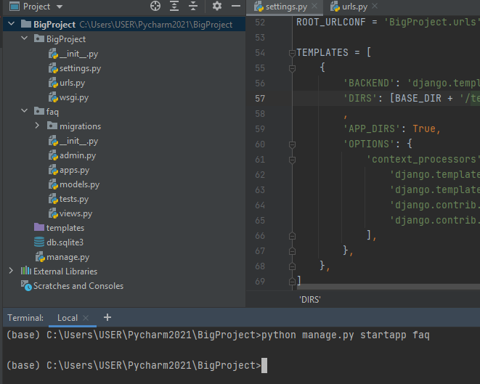
e. Start app
1. Framework coding
1.
python manage.py startapp faq
Create a new app “faq”
Type:
It will show a new folder with a list of Python files (admin, apps, models, tests, and views)
faq: frequently asked questions

Slide 14
f. Setting the new app
1. Framework coding
Go to “settings.py”
Add a new INSTALLED_APPS
INSTALLED_APPS = [
'django.contrib.admin',
'django.contrib.auth',
'django.contrib.contenttypes',
'django.contrib.sessions',
'django.contrib.messages',
'django.contrib.staticfiles',
'faq.apps.FaqConfig'
]

Slide 15
Model Coding
Database

Slide 16
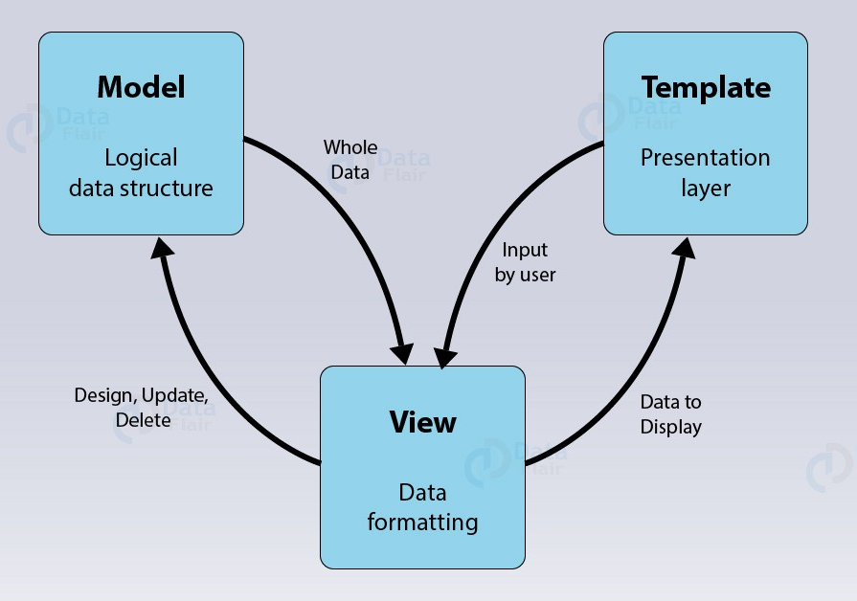
Django Architecture Components
Model
  M stands for “Model,” the data access layer. This layer contains anything and everything about the data: how to access it, how to validate it, which behaviors it has, and the relationships between the data.
Template
  T stands for “Template,” the presentation layer. This layer contains presentation-related decisions: how something should be displayed on a Web page or other type of document.
View
  V stands for “View,” the business logic layer. This layer contains the logic that access the model and defers to the appropriate template(s). You can think of it as the bridge between models and templates.
https://towardsdatascience.com/working-structure-of-django-mtv-architecture-a741c8c64082

Slide 17
Problem
Suppose, you are required to build a website to receive a question and find the possible answers for the question from the crowd.
You need to save all the questions and answers into the database.
How will you make it?

Slide 18
The order of Code - Revisit
The order of code | Related command / file | Contents of the code
Framework coding | Start project | The new project creation
 | settings.py | Project setting modification
 | migrate | User / group table creation
 | createsuperuser | Project admin super-user creation
 | startapp | Bookmark app production
 | settings.py | Bookmark app registration
Model coding | models.py | Model / Table definition
 | admin.py | Admin site model registration
 | makemigrations | Model modification commit
 | migrate | Any modification execution
View coding | views.py | View logic registration
URLconf coding | urls.py | URL definition
Template coding | templates directory | Web files creation
Framework Coding
This Section
Model Coding

Slide 19
a. models
2. Model coding
Create model / table definition
In the folder "faq", Open “models.py”
models.py
from django.db import models
from django.utils import timezone
class Question(models.Model):
question_text = models.CharField(max_length=200)
pub_date = models.DateTimeField('date published')
def __str__(self):
return self.question_text
class Choice(models.Model):
question = models.ForeignKey(Question, on_delete=models.CASCADE)
choice_text = models.CharField(max_length=200)
votes = models.IntegerField(default=0)
url = models.URLField('URL',unique=True)

Slide 20
About the Model
In our simple faq app, there are two models: Question and Choice.
Entity Relationship Diagram (ERD) for "models.py"
Question
Choice
question_text: CharField(200)
pub_date: DateTimeField
question: FK
choice_text: CharField(200)
vote: IntegerField(0)
url: URLField(unique=True)
A Question has a question and a publication date. A Choice has two fields: the text of the choice and a vote tally. Each Choice is associated with a Question.

Slide 21
Model Example (explanation)
django.db.models.Model
CharField
DateTimeField
IntegerField
URLField
ForeignKey
from django.db import models
from django.utils import timezone
class Question(models.Model):
question_text = models.CharField(max_length=200)
pub_date = models.DateTimeField('date published')
class Choice(models.Model):
question = models.ForeignKey(Question, on_delete=models.CASCADE)
choice_text = models.CharField(max_length=200)
votes = models.IntegerField(default=0)
url = models.URLField('URL',unique=True)

Slide 22
Model Example (explanation)
Some Field classes have required arguments.
  CharField, for example, requires that you give it a max_length. That is used not only in the database schema, but in validation.
  A Field can also have various optional arguments; in this case, we have set the default value of votes to 0.
A relationship is defined, using ForeignKey. That tells Django each Choice is related to a single Question. Django supports all the common database relationships: many-to-one, many-to-many, and one-to-one.
from django.db import models
from django.utils import timezone
class Question(models.Model):
question_text = models.CharField(max_length=200)
pub_date = models.DateTimeField('date published')
class Choice(models.Model):
question = models.ForeignKey(Question, on_delete=models.CASCADE)
choice_text = models.CharField(max_length=200)
votes = models.IntegerField(default=0)
url = models.URLField('URL',unique=True)

Slide 23
b. admin
2. Model coding
admin.py
from django.contrib import admin
from faq.models import Question, Choice
admin.site.register(Question)
admin.site.register(Choice)

Slide 24
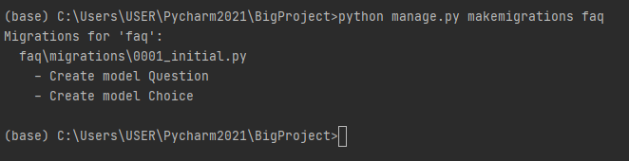
c. makemigrations
2. Model coding
Since there are some changes on the database, we need to migrate again.
Before doing the migration, we need to run “makemigrations”
python manage.py makemigrations faq

Slide 25
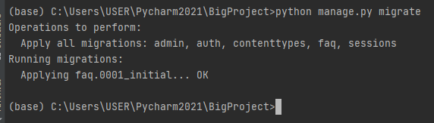
d. migrate
2. Model coding
Lastly, do “migrate” to put all contents into the Django environment.
python manage.py migrate

Slide 26
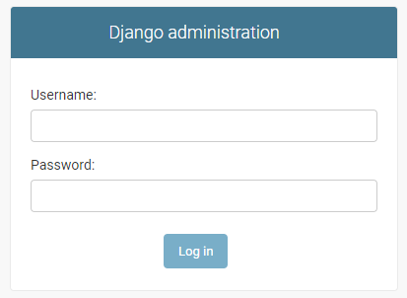
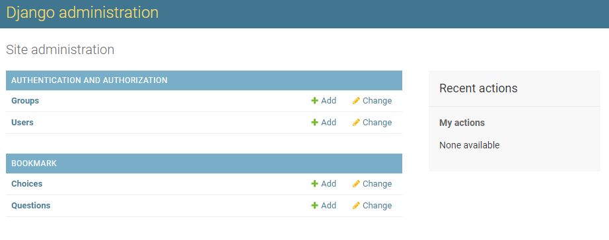
Run the program
2. Model coding
Run the project “BigProject”
Go to the link for admin
Input your data:
  Username: user
  Password: hufsime203
http://127.0.0.1:8000/admin/

Slide 27
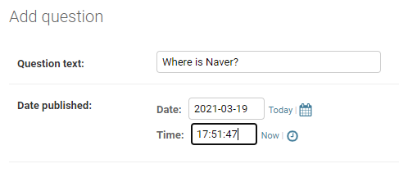

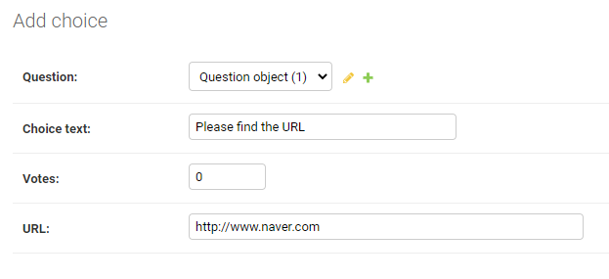

Add 1 data
2. Model coding
1.
2.

Slide 28
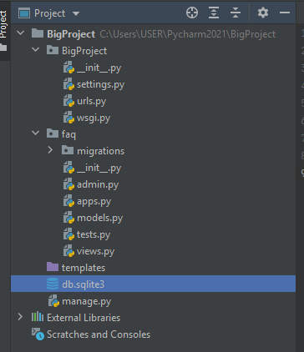
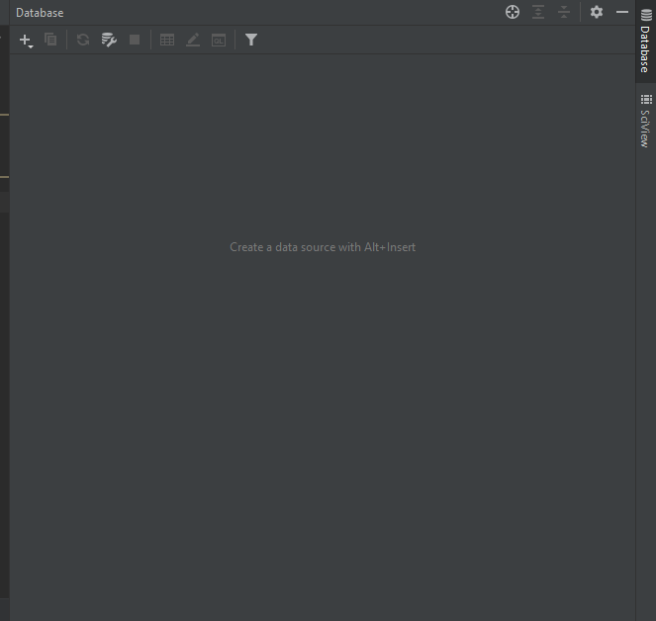
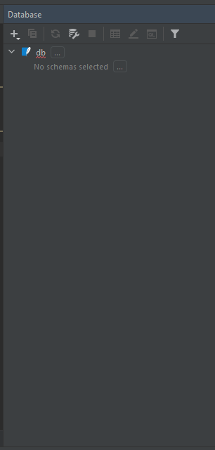
See the Database (1)
2. Model coding
1. Drag and Drop

Slide 29
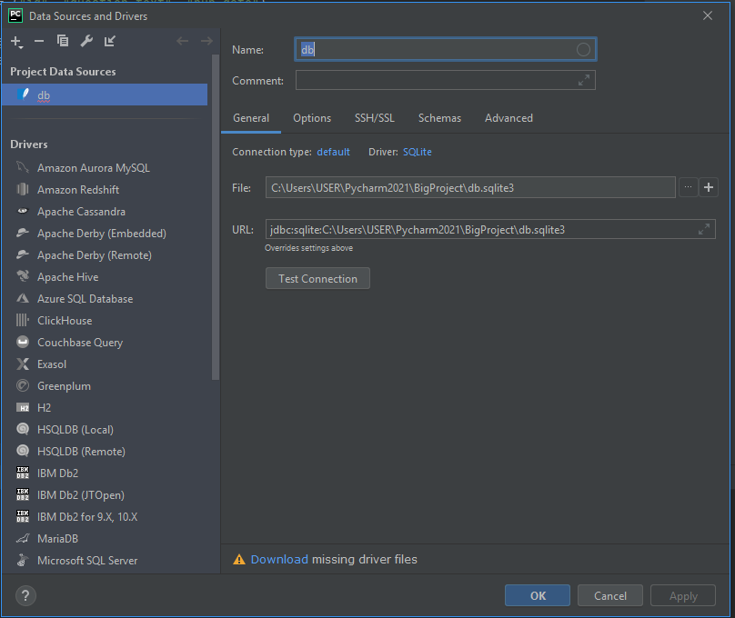
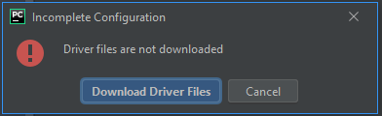
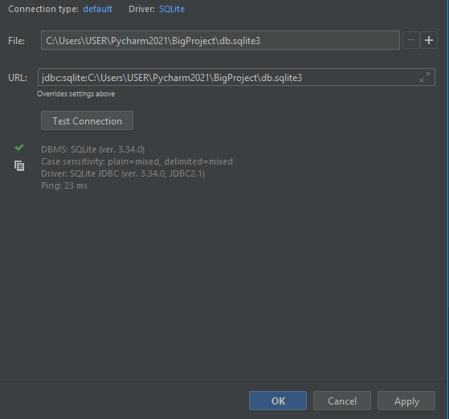
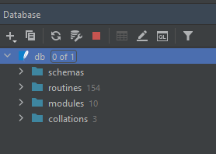
See the Database (2)
2. Model coding
Click “refresh” if there is no properties

Slide 30
Configuring the DB
By default, the configuration uses SQLite.
If you wish to use another database, install the appropriate database bindings and change the following keys in the DATABASES 'default' item to match your database connection settings

Slide 31
Configuring the DB
ENGINE – Either
  'django.db.backends.sqlite3',
  'django.db.backends.postgresql',
  'django.db.backends.mysql',
  or 'django.db.backends.oracle'.
  Other backends are also available.
NAME – The name of your database. If you’re using SQLite, the database will be a file on your computer; in that case, NAME should be the full absolute path, including filename, of that file.
The default value, os.path.join(BASE_DIR, 'db.sqlite3'), will store the file in your project directory.

Slide 32
Configuring the DB
By default, INSTALLED_APPS contains the following apps, all of which come with Django:
  django.contrib.admin – The admin site. You’ll use it shortly.
  django.contrib.auth – An authentication system.
  django.contrib.contenttypes – A framework for content types.
  django.contrib.sessions – A session framework.
  django.contrib.messages – A messaging framework.
  django.contrib.staticfiles – A framework for managing static files.

Slide 33
Installing the model (explanation)
Migrations are very powerful and let you change your models over time, as you develop your project, without the need to delete your database or tables and make new ones.
For now, remember the three-step guide to making model changes:
  Change your models (in models.py).
  Run python manage.py makemigrations to create migrations for those changes
  Run python manage.py migrate to apply those changes to the database.

Slide 34
Some more explanations
Note the following:
The example above is generated for sqlite3.
Table names are automatically generated by combining the name of the app (faq) and the lowercase name of the model – question and choice. (You can override this behavior.)
Primary keys (IDs) are added automatically. (You can override this, too.)
By convention, Django appends "_id" to the foreign key field name. (Yes, you can override this, as well.)

Slide 35
Some more explanations
The foreign key relationship is made explicit by a FOREIGN KEY constraint.
Different database have different field types for primary key automatic generators:
  auto_increment(MySQL),
  serial (PostgreSQL), or
  integer primary key autoincrement (SQLite)
The sqlmigrate command doesn’t actually run the migration on your database - it just prints it to the screen so that you can see what Structured Query Language (SQL) Django thinks is required.
Different database may have different ways to query the data.

Slide 36
SQL
Structured Query Language

Slide 37
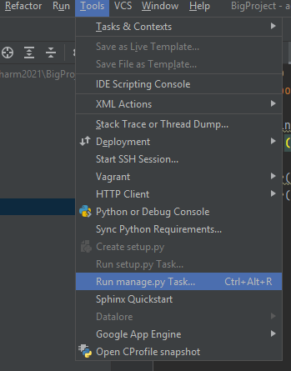
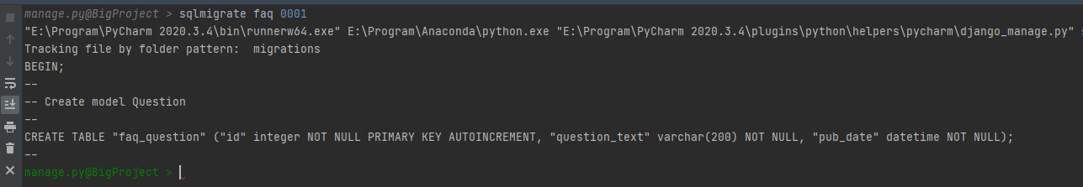
Installing the model
There’s a command that will run the migrations for you and manage your database schema automatically - that’s called migrate, and we’ll come to it in a moment - but first, let’s see what SQL that migration would run. The sqlmigrate command takes migration names and returns their SQL:
1.
2.
Type the following:
1. sqlmigrate faq 0001
2. migrate

Slide 38
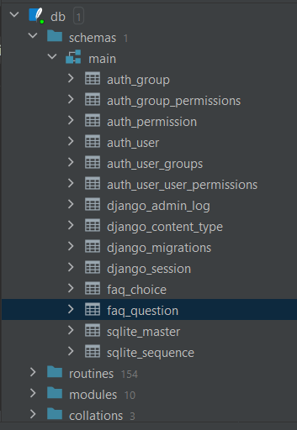
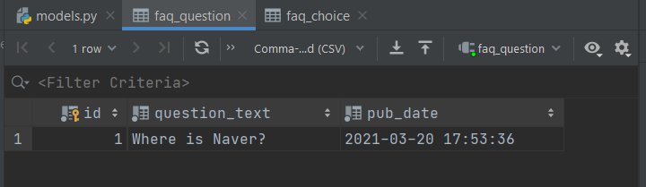
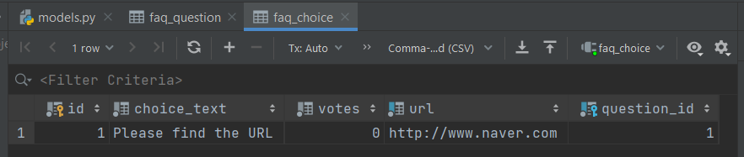
Checking the data

Slide 39
Data Access
A few ways to access the data

Slide 40
Data Access
Python Shell vs Structured Query Language
Python Shell
  Use the Python code to access the data
  It can be used in the View (V) and Template (T)
Structured Query Language (SQL)
  Use SQL language in accordance to the Database tool
  It can be used in the View (V) and need to be translated into Template (T)
In this chapter, we will adopt the Python Shell rather than SQL.

Slide 41
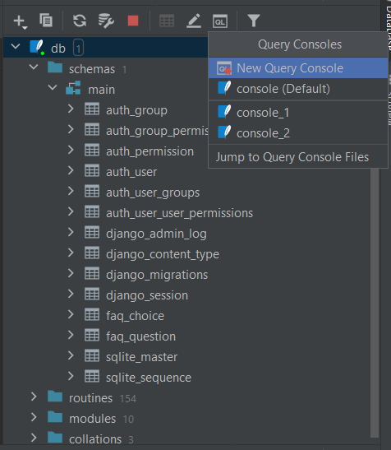
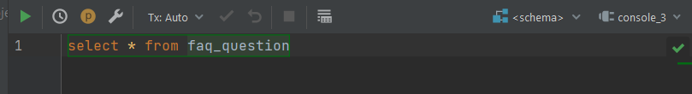
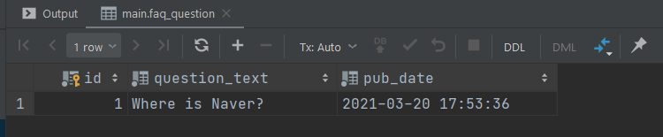
Data Access via SQL

Slide 42
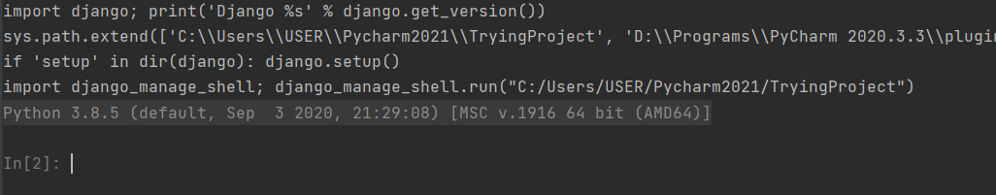
Data Access – via Shell
Basic Query in Shell
In order to access the DB, we can use a python function in a shell.
Execute this:
1. Run manage.py task (Ctrl + Alt + R)
2. Type: shell
3. A new console will open (see below)

Slide 43
Starter – View all data from the models
Statement | Result
from faq.models import Question, Choice
Question.objects.all() | <QuerySet [<Question: Where is Naver?>]>
Choice.objects.all() | <QuerySet [<Choice: Choice object (1)>]>

Slide 44
CRUD – Create Read Update and Delete
CRUD are the four basic functions in any computer programming.
The acronym CRUD refers to all of the major functions that are implemented in relational DB.
Each of the letter can map to a standard SQL (Structured Query Language), HTTP (Hypertext Transfer Protocol), and DDS (Data Distribution Service)
Operation | SQL | HTTP | DDS
Create | Insert | PUT / POST | Write
Read (Retrieve) | SELECT | GET | Read / take
Update (Modify) | UPDATE | PUT / POST / PATCH | Write
Delete (Destroy) | DELETE | DELETE | Dispose

Slide 45
CRUD in Django
Some existing CRUD packages for Django
  https://djangopackages.org/grids/g/crud/
In this lecture, we will learn basic CRUD using Models provided in Django

Slide 46
Model Example (for convenience)
The result is not well-represented.
For better representation, we need to add more functions.
Edit the Question model (in the faq/models.py file) and add a __str__() method to both Question and Choice:

Slide 47
Model Example
Append more functions in the "models.py"
After updating the files,
do the following:
1. makemigrations
2. migrate
3. Restart the shell
from django.db import models
from django.utils import timezone
import datetime
class Question(models.Model):
# ……THIS IS YOUR PREVIOUS CODE
def __str__(self):
return self.question_text
def was_published_recently(self):
return self.pub_date >= timezone.now() - datetime.timedelta(days=1)
class Choice(models.Model):
# …… THIS IS YOUR PREVIOUS CODE
def __str__(self):
return self.choice_text

Slide 48
Add / Modify data
Statement | Explanations
from faq.models import Question, Choice | Call the models
from django.utils import timezone | Use timezone function
q = Question(question_text="What's new?", pub_date=timezone.now()) | Create a new object
q.save() | Save the object q
q.id | Show the id of object q
q.question_text | Show the question text of object q
q.pub_date | Show the publication date of object q
q.question_text = "What’s up?" | Modify the contents of the question of object q
q.save() | Save the modifications
Question.objects.all() | Show all objects

Slide 49
Read Data
Statement | Explanations
from faq.models import Question, Choice | Call the models
from django.utils import timezone | Use the timezone function
q2 = Question.objects.create(question_text = "What's your favorite pet?", pub_date = timezone.now()) | Add a new object and put it into an object q2
Question.objects.all() | List all the objects

Slide 50
Read Data (filter vs get)
 | Statement | Explanations
a. | Question.objects.filter(id=1) | Filter ID=1
b. | Question.objects.filter(pk=1) | Filter primary key=1
c. | Question.objects.filter(question_text__startswith='What') | Filter objects that starts with ‘What’
d. | Question.objects.filter(question_text__contains='hat') | Filter objects that contains “hat”
e. | Question.objects.filter(question_text__contains = "What").values()
f. | Question.objects.filter(question_text__contains = "What").values('id','question_text')
g. | Question.objects.filter(id__in=[1,3])
 | Statement | Explanations
a. | Question.objects.get(pk=3) | Select object primary key = 3
b. | Question.objects.get(pk=1) | Select object primary key = 3
c. | Question.objects.get(question_text__startswith='What') | Select object with questions starts with “What” | ERROR!
d. | q = Question.objects.get(pk=1) | Call the object primary key=1 and put it into object q
e. | q.was_published_recently() | Show the q as written in the function

Slide 51
The concept of “get” and “filter”
We use “get” to only read one data. When it finds more than one (1) data, it shows error.
We use “filter” to read all data that satisfy the conditions. When it finds more than one (1) data, it shows all the data.

Slide 52
Add Data (Choice)
Statement | Explanations
q = Question.objects.get(pk=1) | Call the object primary key = 1 and put it into the object q
q.choice_set.all() | Select all objects in Choice which relates to q
q.choice_set.create(choice_text='Not much', votes=0, url="https://www.naver.com") | Create a new object in Choice which relates to q
q.choice_set.create(choice_text='I do not know', votes=0, url="http://m.naver.com") | Create a new object in Choice which relates to q
c = q.choice_set.create(choice_text='Just hacking again', votes=0, url="www.naver.com") | Create a new object c in Choice which relates to q
c.question | Select the question of object c
q.choice_set.all() | Select the objects in Choice related to object q
q.choice_set.count() | Count the objects in Choice related to object q

Slide 53
Read Data (Choice)
Statement | Explanations
Choice.objects.values_list() | Show the list of objects in Choice
Choice.objects.values_list().order_by('choice_text') | Show the list of objects in Choice and sort by “choice_text”
c = Choice.objects.get(id=4) | Call the Choice object id=4
c.votes = 5 | Modify the attribute votes into 5
c.save() | Save the modification
Choice.objects.get(id=4).votes | Show the votes of object Choice id = 4
Choice.objects.order_by('-votes') | Show the objects sorted in descending on the attribute “votes”
Choice.objects.order_by('choice_text', 'votes') | Show the objects sorted first by choice_text and then by votes
Choice.objects.filter(votes = 0).order_by('choice_text') | Filter the data with votes = 0 and sorted by choice_text

Slide 54
Delete Data (Choice)
Statement | Explanations
Choice.objects.get(id=3) | Select the object with id=3
s = Choice.objects.get(id=3) | Put the object with id=3 into object s
s.delete() | Delete s
Choice.objects.all() | Show all objects in Choice

Slide 55
Making Changes to DB Schema
Let’s say that you are going to append a column in the Table "Choice".
class Choice(models.Model):
# .. ..
dislike = models.IntegerField(default=0)

Slide 56
Making Changes to DB Schema
Run the makemigrations
After some changes happen, run migrate
The new column has been set up.
You can check through Python Shell
python manage.py makemigrations faq
python manage.py migrate

Slide 57
Python Shell
Statement | Explanations
from faq.models import Question, Choice | Call the models
Choice.objects.all() | Select all objects in Choice
Choice.objects.value_list() | Show the value list of all objects in Choice
Choice.objects.values() | Select all values in Choice

Slide 58
View – URL - Template Coding

Slide 59
The order of Code
The order of code | Related command / file | Contents of the code
Framework coding | Start project | The new project creation
 | settings.py | Project setting modification
 | migrate | User / group table creation
 | createsuperuser | Project admin super-user creation
 | startapp | Bookmark app production
 | settings.py | Bookmark app registration
Model coding | models.py | Model / Table definition
 | admin.py | Admin site model registration
 | makemigrations | Model modification commit
 | migrate | Any modification execution
View coding | views.py | View logic registration
URLconf coding | urls.py | URL definition
Template coding | templates directory | Web files creation
Framework Coding
Model Coding
This Section

Slide 60
View coding
views.py
urls.py
HTML
In the "views.py" (folder 'faq'), write two functions for each of the model
from django.shortcuts import render, redirect
from faq.models import Question, Choice
def list_questions(request):
questions = Question.objects.all()
return render(request, 'list_quest.html', {'questions' : questions})
def list_choice(request, id):
choice = Choice.objects.filter(question_id=id)
return render(request, 'list_choice.html', {'choices' : choice})
There is one parameter id.
It is to indicate the choices related to the question ID

Slide 61
URLconf Coding
views.py
urls.py
HTML
Add the code in the "urls.py" (in folder faq)
from django.urls import path
from faq import views
urlpatterns = [
path('', views.list_questions, name = 'list_questions'),
path('<int:id>/', views.list_choice, name = 'list_choice'),
]
The ID (integer) will be the URL to indicate the choices of a question.

Slide 62
URLconf Coding
views.py
urls.py
HTML
Add the code in the "urls.py" (in the parent folder)
from django.contrib import admin
from django.urls import path, include
urlpatterns = [
path('admin/', admin.site.urls),
path('faq/', include('faq.urls')),
]
Call the urls.py in the apps "faq" when the user click the URL /faq

Slide 63
Template Coding
views.py
urls.py
HTML
Create a HTML file name "list_quest.html" in the folder templates
<!DOCTYPE html>
<html lang="en">
<head>
<meta charset="UTF-8">
<title>Frequently Asked Questions</title>
</head>
<body>
<ul>
{% for i in questions %}
<li> {{ i.question_text }}, {{ i.pub_date }} <a href ="{%url 'list_choice' i.id %}" >Check Choice </a></li>
{% endfor %}
</ul>
</body>
</html>
List all the questions from the DB
Call the column based on the object i.
Call the choices according to the ID.

Slide 64
Template Coding
views.py
urls.py
HTML
Create a HTML file name "list_choice.html" in the folder templates
<!DOCTYPE html>
<html lang="en">
<head>
<meta charset="UTF-8">
<title>List of Choices</title>
</head>
<body>
<ul>
{% for i in choices %}
<li> {{ i.choice_text }}, <a href="{{ i.url }}"> , {{ i.url }} </a></li>
{% endfor %}
</ul>
</body>
</html>
Call the attributes in the table choice.

Slide 65
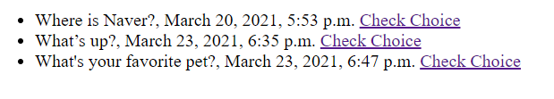
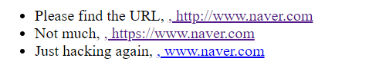
Run Django
http://127.0.0.1:8000/faq/
http://127.0.0.1:8000/faq/1/

Slide 66
Note
M: Model (classes in Model) with SQLite
V: Views with relevant functions to connect to the HTML files via URL calls
T: Templates with relevant HTML files

Slide 67
Summary
Configuring the DB
Defining Model in Python
Installing the Model
Data Access
Inserting and Updating the Data
Selecting Objects
Deleting Objects
Making Changes to DB Schema
Connecting to Django Admin
Displaying the Data into HTML

Slide 68
References
http://django.readthedocs.io/en/latest/intro/tutorial02.html

